Slide 1

Eatinerary: A food-based Itinerary planning app
Presenter Name
Aravind Dendukuri
NagaJahnavi Dhulipalla
Vaibhav Lodhiya

Slide 2
Project Scope:
Our project focuses on leveraging a meticulously curated dataset, comprising CSV files extracted from TripAdvisor's things to do page, United States zip codes page, and Yelp's provided academic data. This comprehensive dataset encompasses vital information about restaurants, attractions, and zip codes, including details such as restaurant names, cuisines, review counts, star ratings, and geographical information. The data serves as a foundational resource for location-based services and recommendations.
Our scope involves developing advanced queries and insights to facilitate restaurant recommendations, cuisine matching, and attraction-based searches. Through thoughtful analysis and application, we aim to unlock the full potential of this rich dataset to enhance user experiences in the realm of location-based services.

Slide 3
Data Collection
In our project, we've harnessed a robust dataset sourced from TripAdvisor's things to do page, United States zip codes page, and Yelp's academic data. This compilation, meticulously crafted without the need for scraping Yelp, is a cornerstone for location-based services and recommendations.
The dataset, comprising crucial details such as restaurant names, cuisines, review counts, star ratings, and geographical information, serves as the bedrock for advanced queries. Our focus is on extracting insights related to restaurant recommendations, cuisine matching, and attraction-based searches, elevating the efficiency and precision of location-based services.

Slide 4
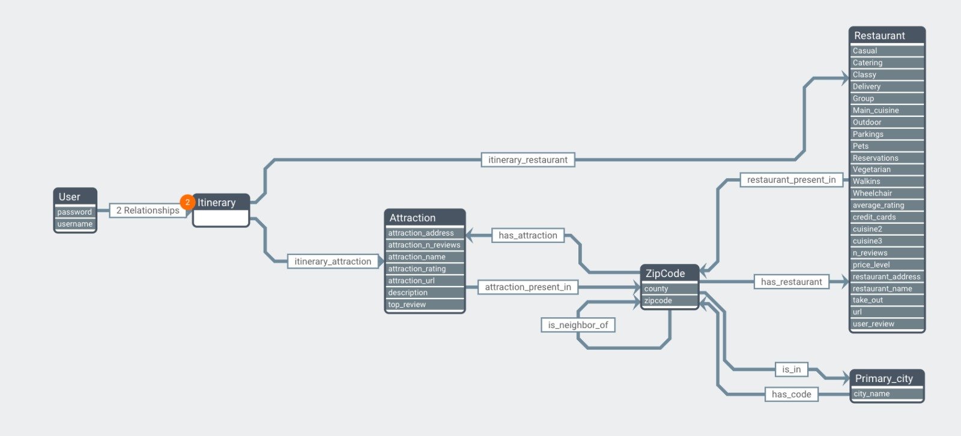
Database Schema

Slide 5
CRUD Operations
In our project, we've got some cool features going on! When a user signs up, we create a special spot for them in Neo4j. Then, we bring that data to life on the frontend for a visual treat.
Now, here's the fun part: when users hop onto the Restaurants page from our dashboard and explore similar spots, they can share their thoughts by updating reviews. It's like giving your favorite places a virtual high-five!
But wait, there's more! On the Past Itinerary page, users can do some virtual spring cleaning. If they're not feeling an entire itinerary, they can just delete it. Poof! It wipes out the whole graph of links for that user and the places they liked. It's like hitting reset, but way more fun. We're all about making it easy and enjoyable for users to navigate and customize their experience!

Slide 6

Thank You!

